Slide 1


Final Demo Presentation
Kelton Chesshire
- Mobile Application

Slide 2

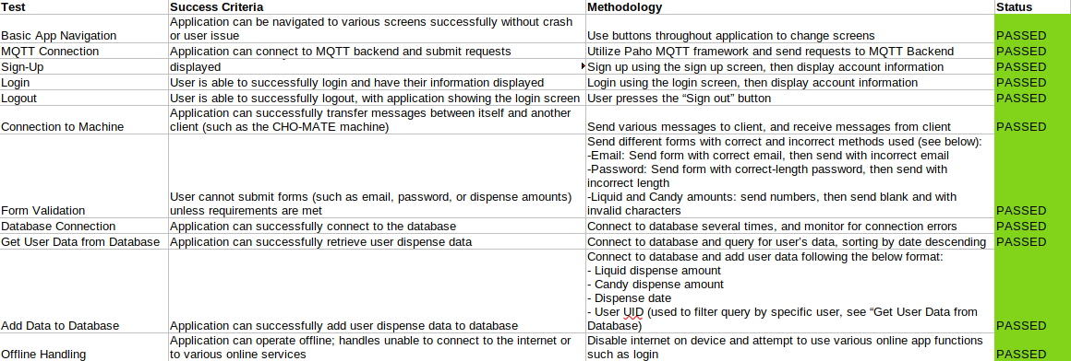
Validation
Phases:
Basic App Navigation
Authentication (Login, Logout)
Sign Up
Form Validation
Database Connection
Connecting with Machine
Error Handling

